Slide 1
Use of IASI in the ECMWF model: evolution and recent advances
Marco Matricardi
ECMWF
with contributions from Mohamed Dahoui, Reima Eeresmaa, Tony McNally, Kirsti Salonen
IASI Exploitation Review – 27 May 2021

Slide 2
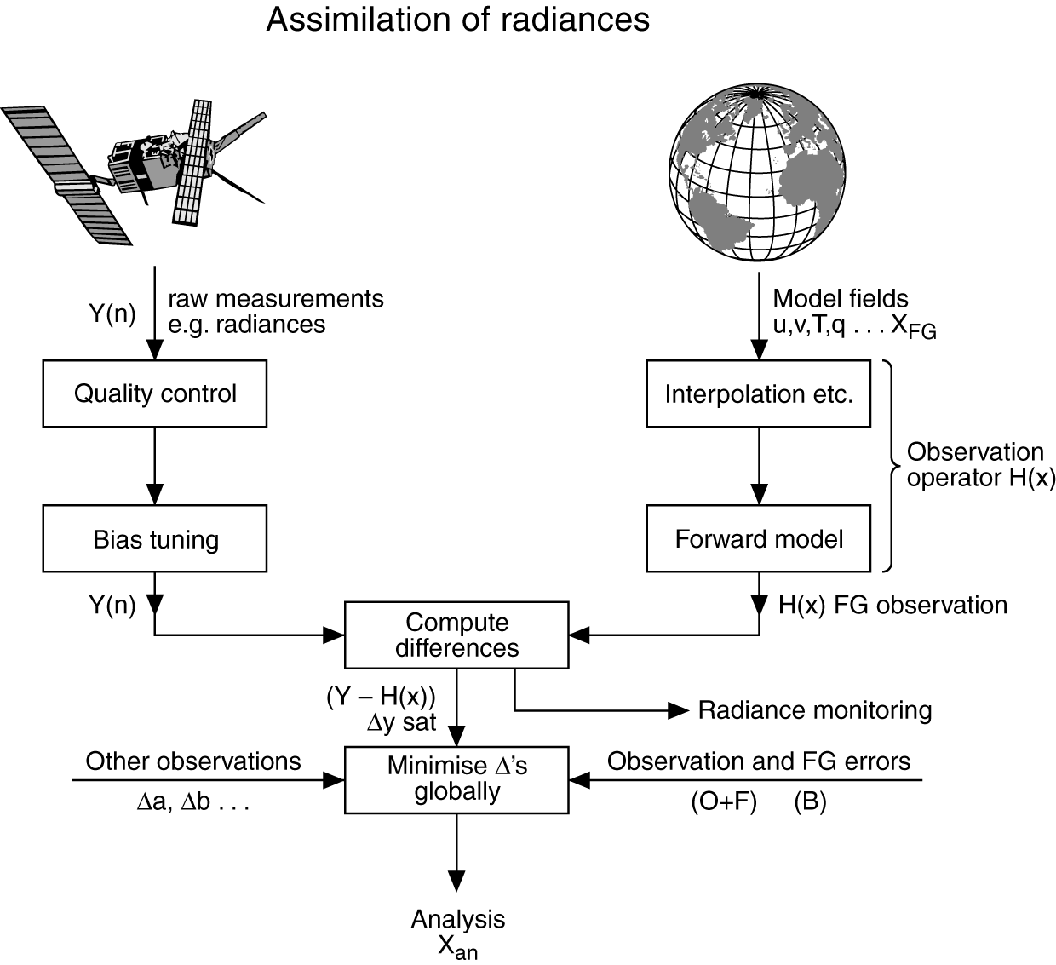
Assimilation of satellite data
Satellite observations
Screening
Interpolation to location of observation
The observation operator computes model equivalents of the observations
Quality control
Radiative transfer model
Compute differences
4D-Var cost function
Observation and forecast errors
x-x_{b}
The atmospheric state that minimises the cost function is referred to as the analysis
X_{b}: a-priori background state, typically a short-range forecast

Slide 3
Satellites used for NWP at ECMWF
OB TYPE | Satellite / sensors | EUROPE | USA | ASIA
Atmospheric Motion Vectors | METOP A,B,C,DUAL (AVHRR) METEOSAT 8,11 (SEVIRI) HIMAWARI 8 (AHI) NPP, NOAA 20 (VIIRS) NOAA 15,18,19 (AVHRR) GOES 15,16 (I/ABI) AQUA (MODIS) | METOP A,B,C + DUAL (AVHRR) METEOSAT 8,11 (SEVIRI) | NPP, NOAA 20 (VIIRS) NOAA 15,18,19 (AVHRR) AQUA (MODIS) GOES 15,16 (ABI) | HIMAWARI 8 (AHI)
Atmospheric Sounding Radiances | METOP A,B,C (AMSU/MHS/IASI) NPP, NOAA 20 (ATMS/CrIS) NOAA 15,18,19 (AMSU/MHS) AQUA (AMSUA/AIRS) FY3-B,C,D (MWHS/MWHS2) METEOSAT 8,11 (SEVIRI) HIMAWARI 8 (AHI) GOES 15,16 (I/ABI) GCOM-W (AMSR-2) GPM (GMI) DMSP 17,18 (SSM/IS) | METOP A,B,C (AMSU/MHS/IASI) METEOSAT 8,11 (SEVIRI) | NPP, NOAA 20 (ATMS/CrIS) NOAA 15,18,19 (AMSU/MHS) AQUA (AMSUA/AIRS) GOES 15,16 (I/ABI) DMSP 17,18 (SSM/IS) | FY3-C,D (MWHS/MWHS2/MWRI) HIMAWARI 8 (AHI) GCOM-W (AMSR-2)
GNSS-RO | METOP A,B,C (GRAS) COSMIC2 Spire (2020) TERRASAR / TANDEM FY3 (GNOS) KOMPSAT5 (GNOS) | METOP A,B,C (GRAS) TERRASAR / TANDEM | COSMIC2 | FY3 (GNOS) KOMPSAT5
SCAT / ALT | METOPA,B,C(ASCAT) / JASON3 / AltiKA / S3A/B / Cry2 | METOP A,B,C (ASCAT) /JASON3 / JASON3 / AltiKA / S3A/B / CRY2
Doppler Wind Lidar | Aeolus

Slide 4
Sensor technology
OB TYPE | Satellite / sensors
Atmospheric Motion Vectors | METOP A,B,C,DUAL (AVHRR) METEOSAT 8,11 (SEVIRI) HIMAWARI 8 (AHI) NPP, NOAA 20 (VIIRS) NOAA 15,18,19 (AVHRR) GOES 15,16 (I/ABI) AQUA (MODIS)
Atmospheric Sounding Radiances | METOP A,B,C (AMSU/MHS/IASI) NPP, NOAA 20 (ATMS/CrIS) NOAA 15,18,19 (AMSU/MHS) AQUA (AMSUA/AIRS) FY3-B,C,D (MWHS/MWHS2) METEOSAT 8,11 (SEVIRI) HIMAWARI 8 (AHI) GOES 15,16 (I/ABI) GCOM-W (AMSR-2) GPM (GMI) DMSP 17,18 (SSM/IS)
GNSS-RO | METOP A,B,C (GRAS) COSMIC2 Spire (2020) TERRASAR / TANDEM FY3 (GNOS) KOMPSAT5 (GNOS)
SCAT / ALT | METOPA,B,C(ASCAT) / Saral JASON3 / AltiKA / S3A/B / Cry2
Doppler Wind Lidar | Aeolus
Sensor technology | Processing route
Passive microwave | L1 Radiances
Passive infrared | L1 Radiances / AMV
Radio occultation | Bending angles
SCAT / Altimeter | L2 wind / SLA / SWH
Doppler wind lidar | L2 LOS wind

Slide 5
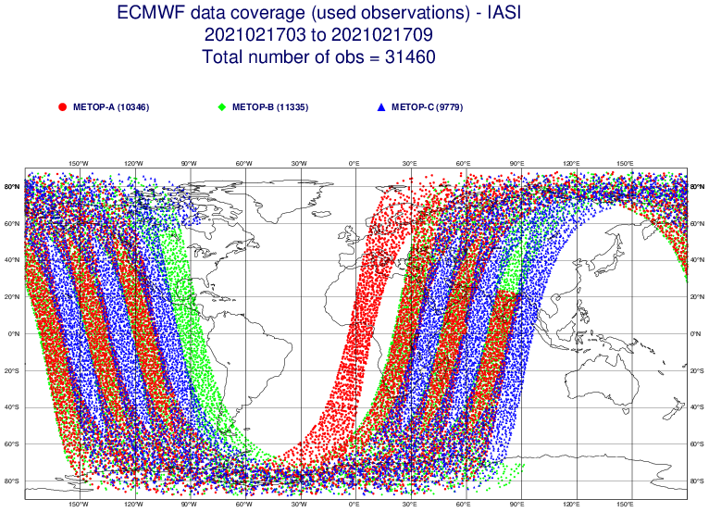
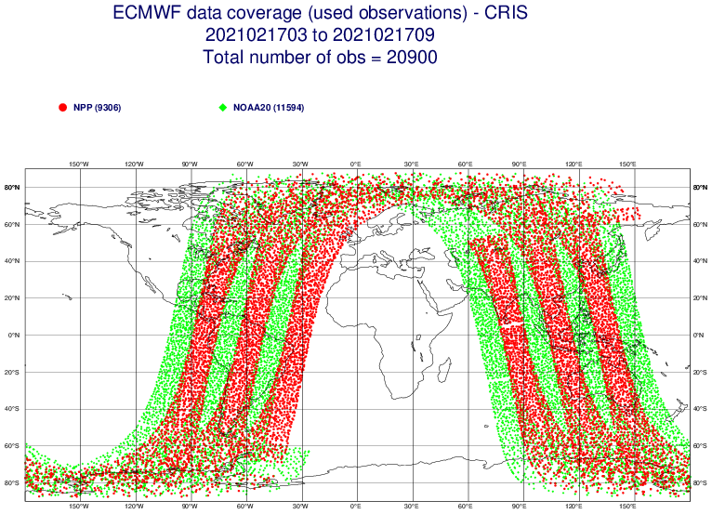
Passive infrared (Low Earth Orbit)
IASI data
CrIS data

Slide 6
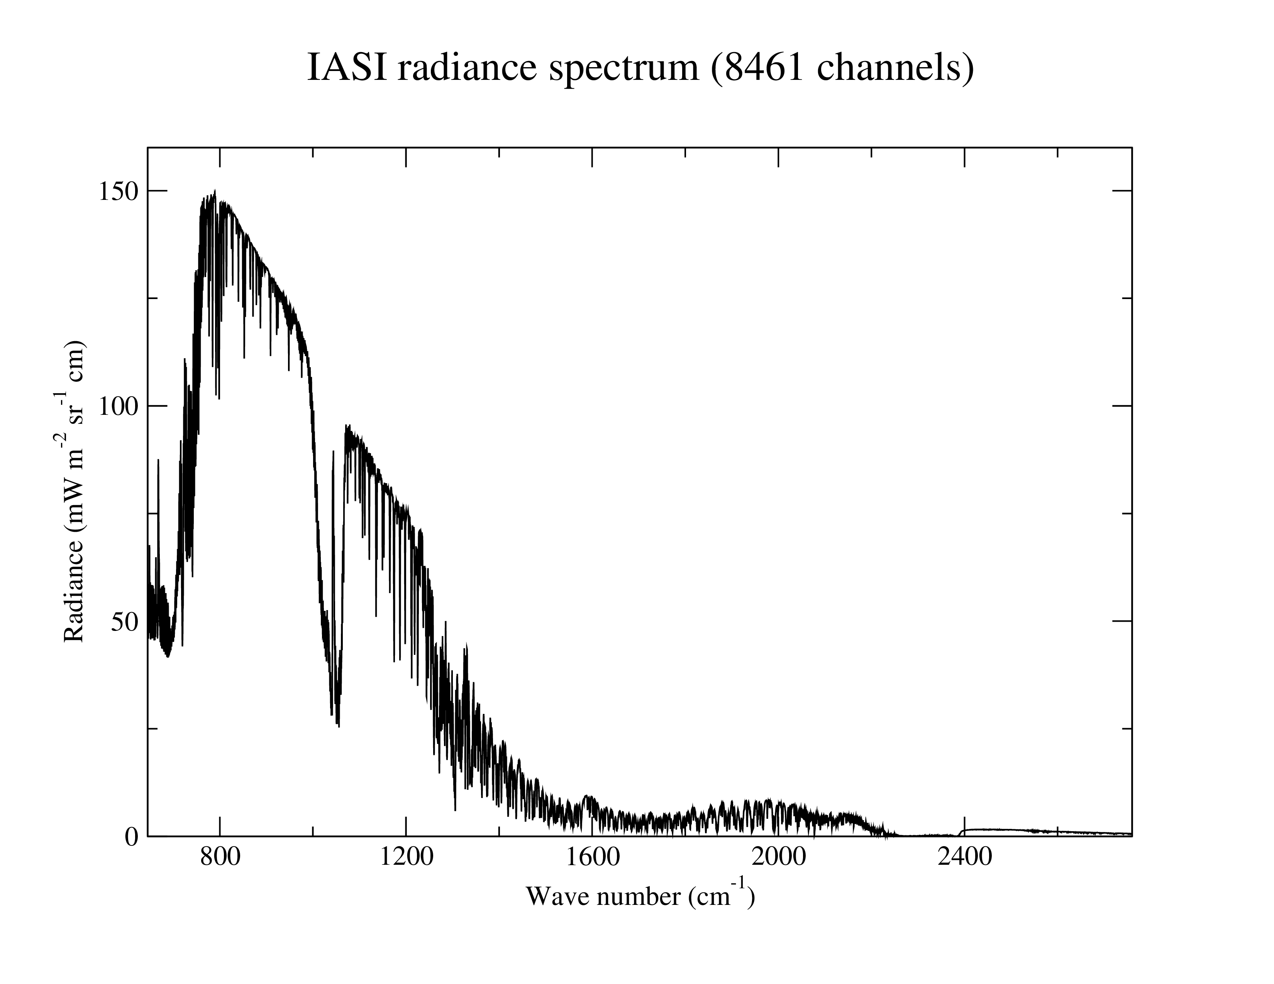
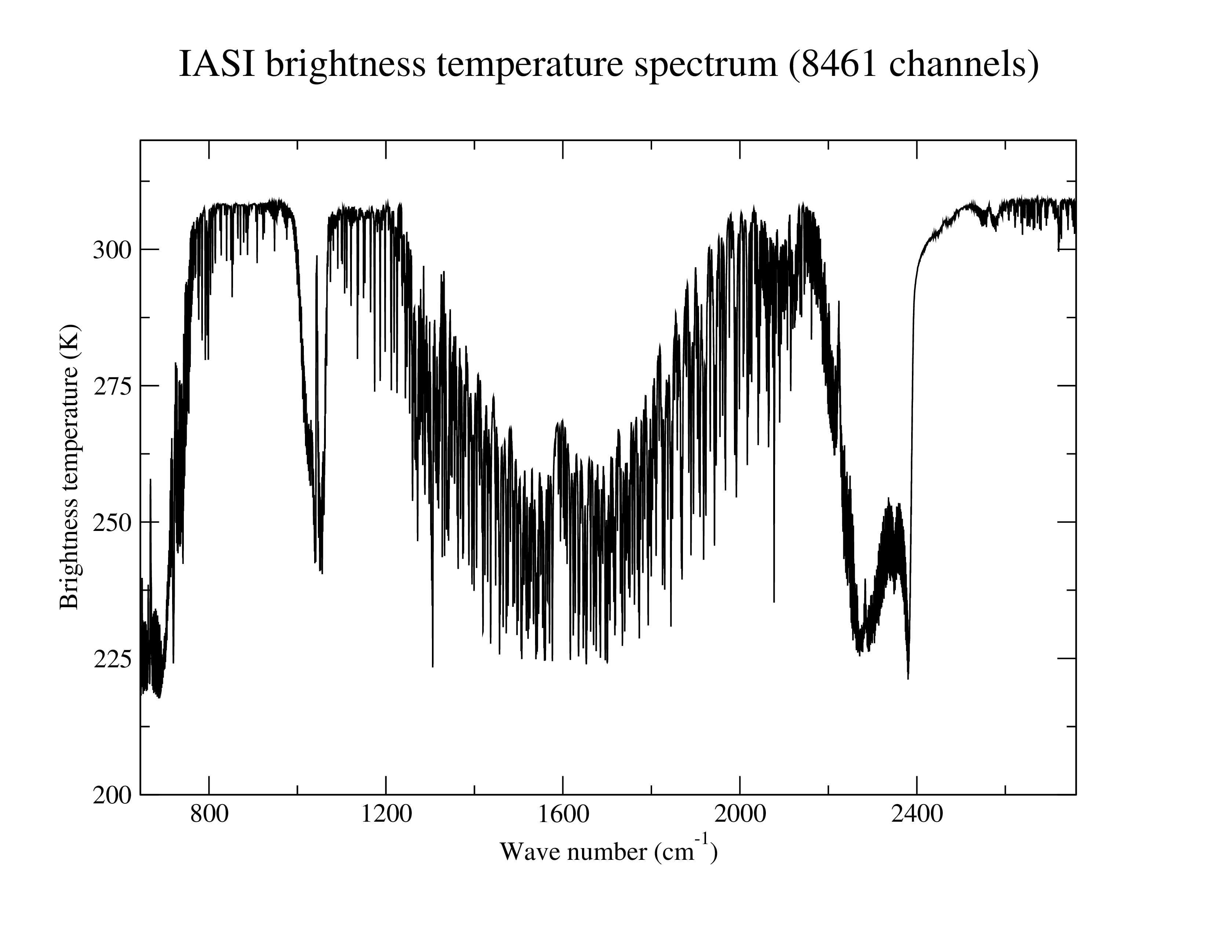
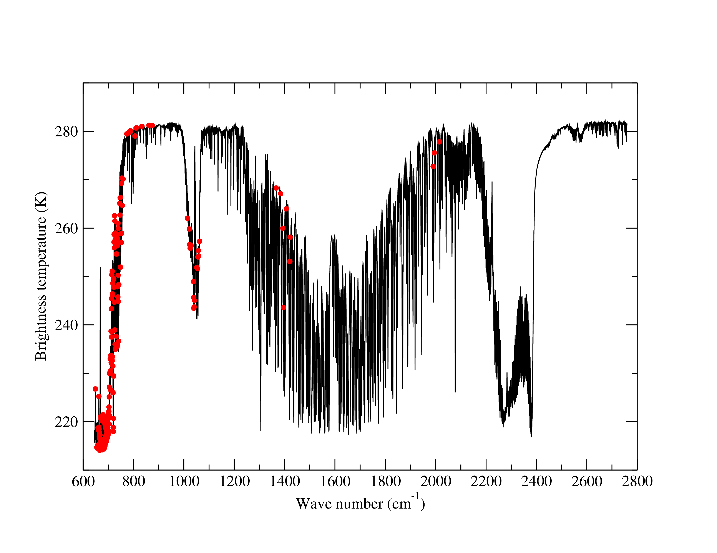
Example of radiance/brightness temperature spectrum
Atmosphere window
Atmosphere window
The 220 operational IASI channels
N₂O absorption
N₂O absorption
CO absorption
Equivalent brightness
temperature spectrum
CH₄ absorption
O₃ absorption
CO₂ absorption
CO₂ absorption
H₂O absorption

Slide 7
How do we asses the impact of modifications to the IASI assimilation system?
We run assimilation experiments!
Impact on the data assimilation system
We can assess satellite influence upon the analysis by examining the fit to in situ observations (radiosonde / aircraft / surface) and how the fit changes when modifications are introduced
We can also assess satellite influence on the analysis by examining the fit to other independent satellite observations which are sensitive to the same atmospheric parameter
Impact on the forecast system
Loss or gain in forecast skill typically looking at forecasts of the 500hPa Geopotential Height (Z)

Slide 8
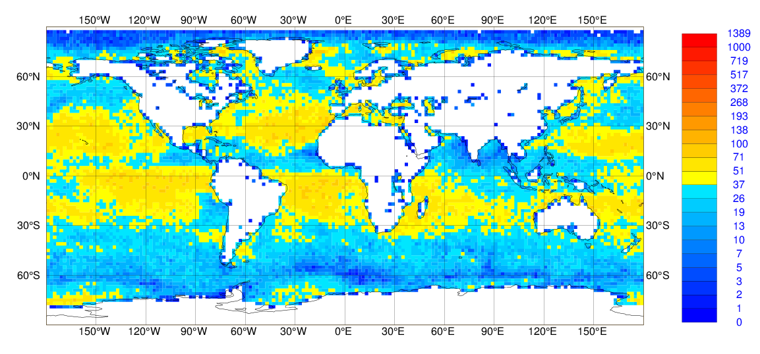
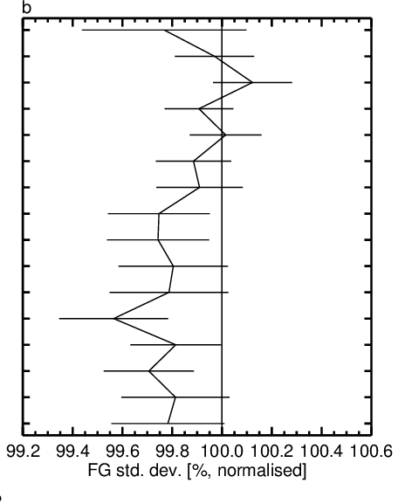
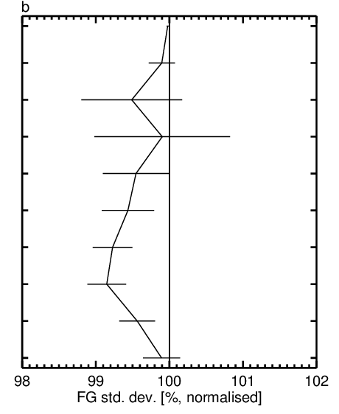
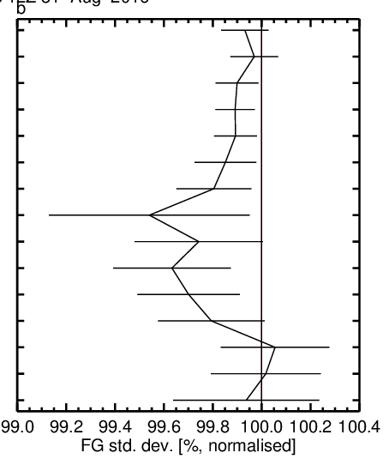
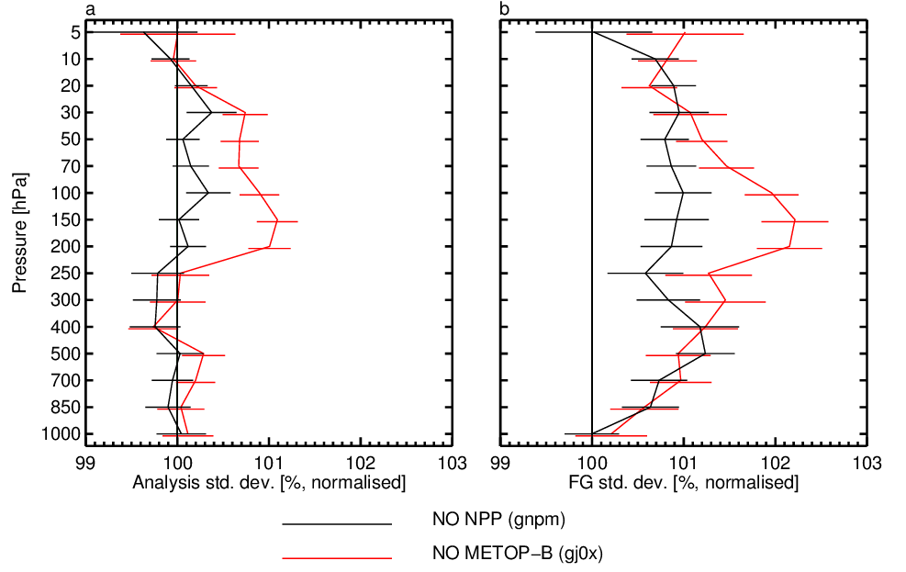
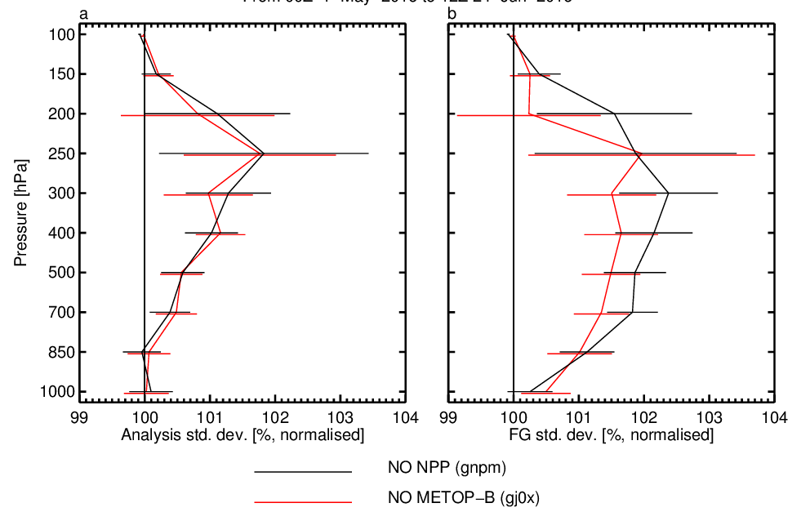
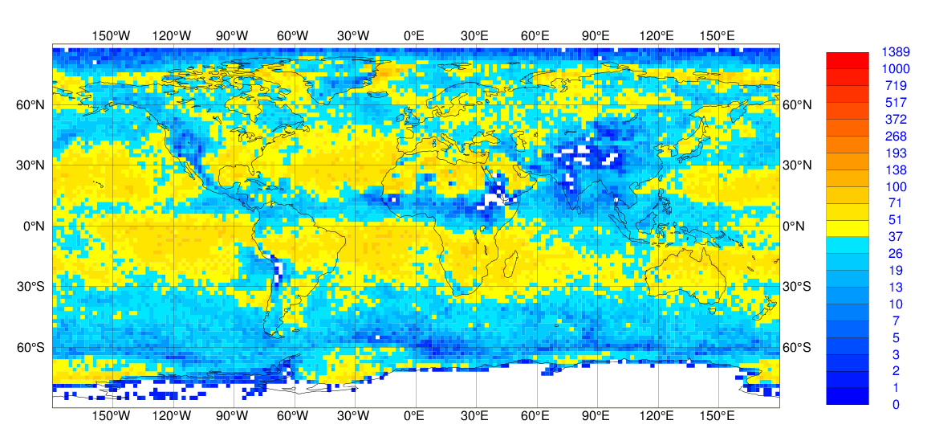
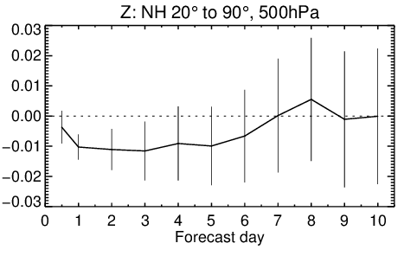
Assimilating IASI spectra over land surfaces
Improved cloud detection over land has allowed hyperspectral IR (e.g. IASI) to be assimilated the same way it is used over ocean
Significant positive impact on the analysis
TEMP-VW
TEMP-T
TEMP-Q
Significant positive impact on the forecasts
Difference in RMS error normalised by RMS error of control experiment
Note this impact is on top of extensive MW data use over land!

Slide 9
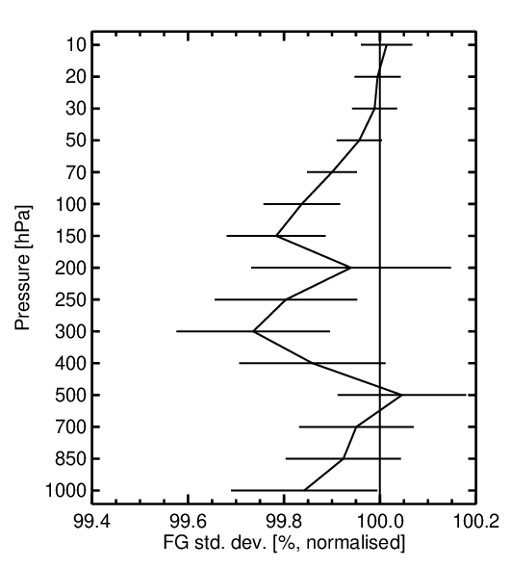
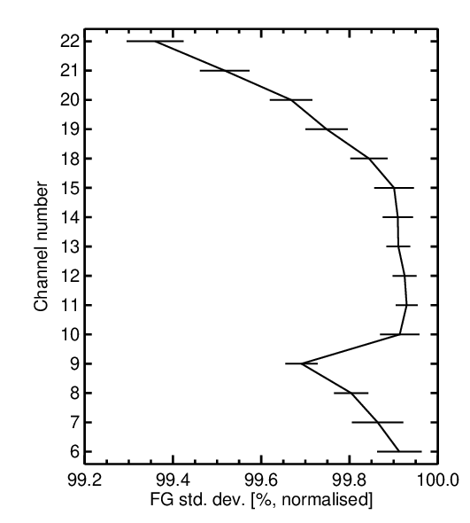
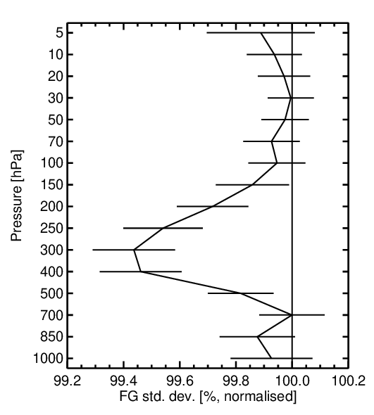
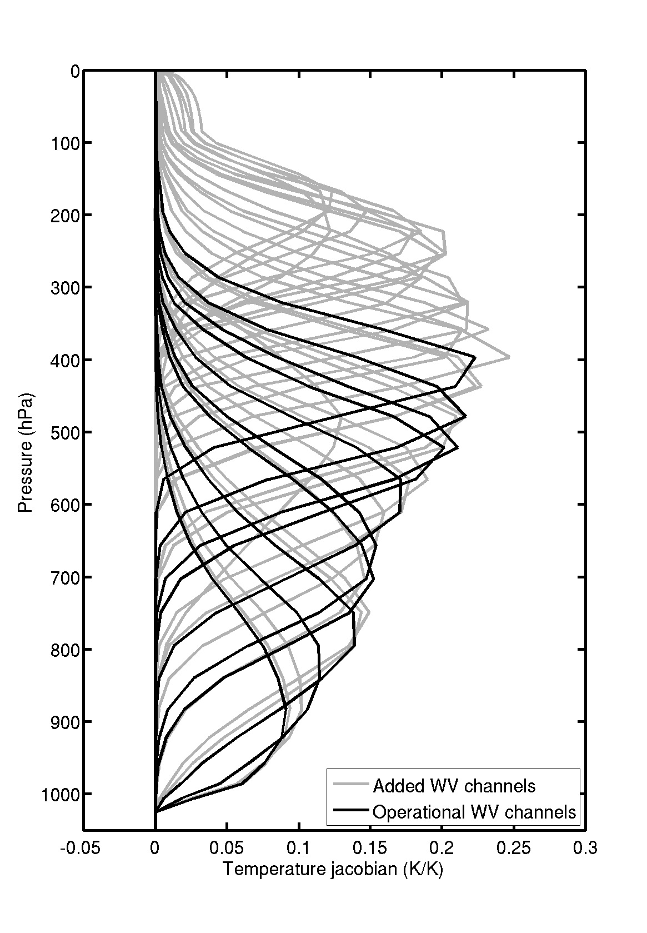
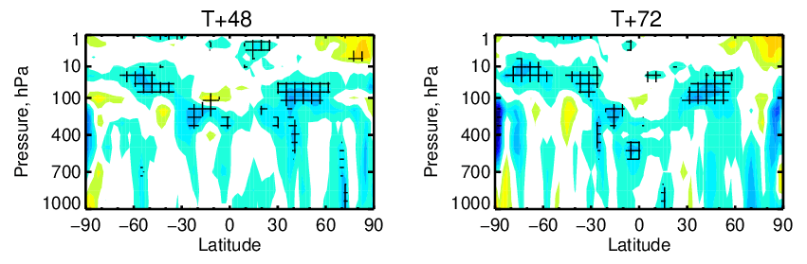
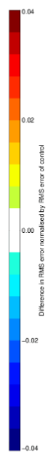
Increasing the number of IASI water vapour channels
Improvement
Degradation
Improvement
Improvement
Degradation
Positive impact on the analysis
TEMP-T
ATMS
TEMP-VW
Difference in RMS error normalised by RMS error of CTL
Degradation
Added WV
channels
Original WV channels
Positive impact on the forecasts
Improvement

Slide 10
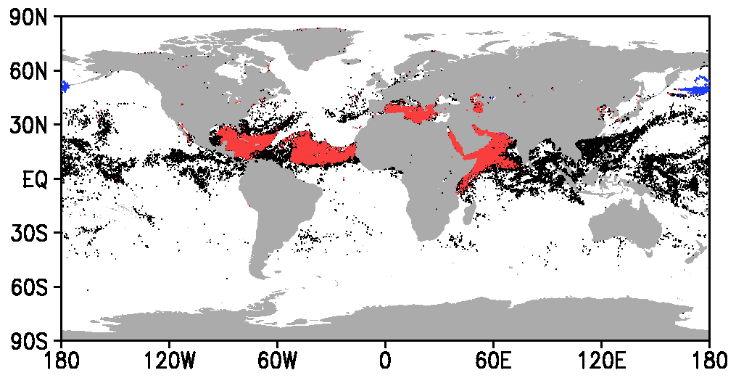
Improvement in the use of IASI data at locations contaminated by aerosols
Previously, the presence of aerosol in the IASI field-of-view resulted in a full-spectrum rejection with no channels being allowed to enter the assimilation.
Now, aerosol-related data rejections are limited to affected channels only. As a result, the amount of assimilated data is considerably increased for stratospheric and upper-tropospheric channels, due to the fact that aerosol layers are frequently confined to the lower- and mid-troposphere.
Aerosol type classification on Metop-B IASI data on 23 June 2019. Red, blue, and black indicate Saharan dust, volcanic ash, and unclassified aerosol, respectively

Slide 11
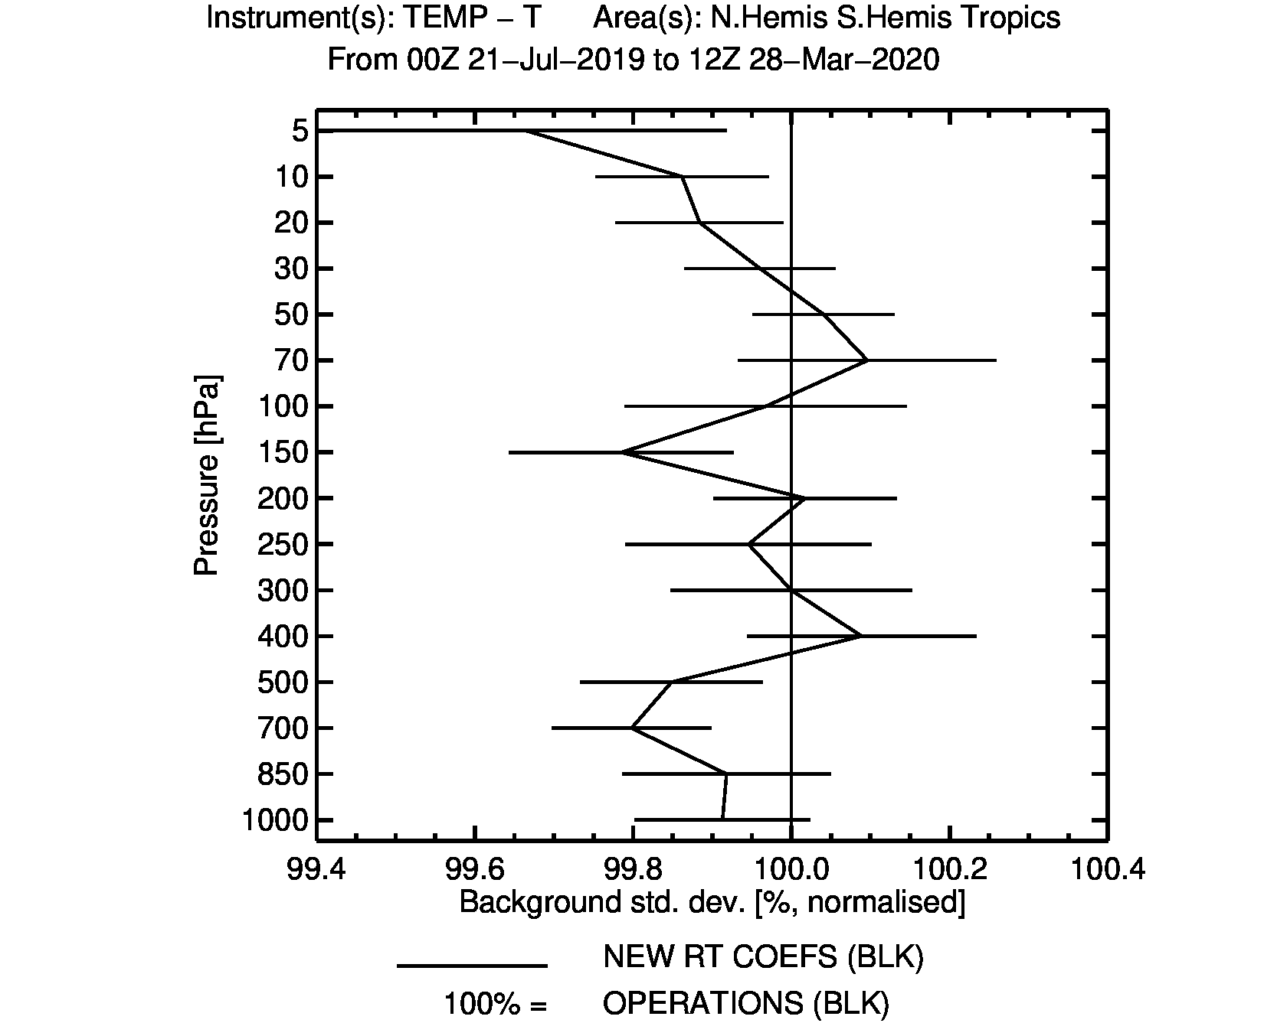
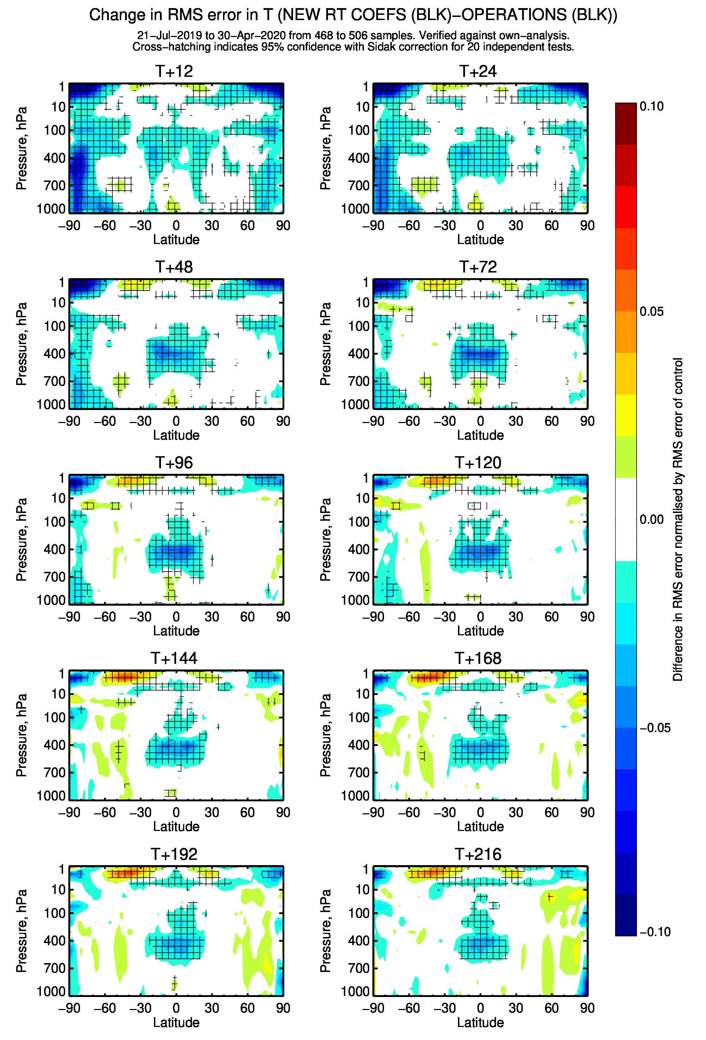
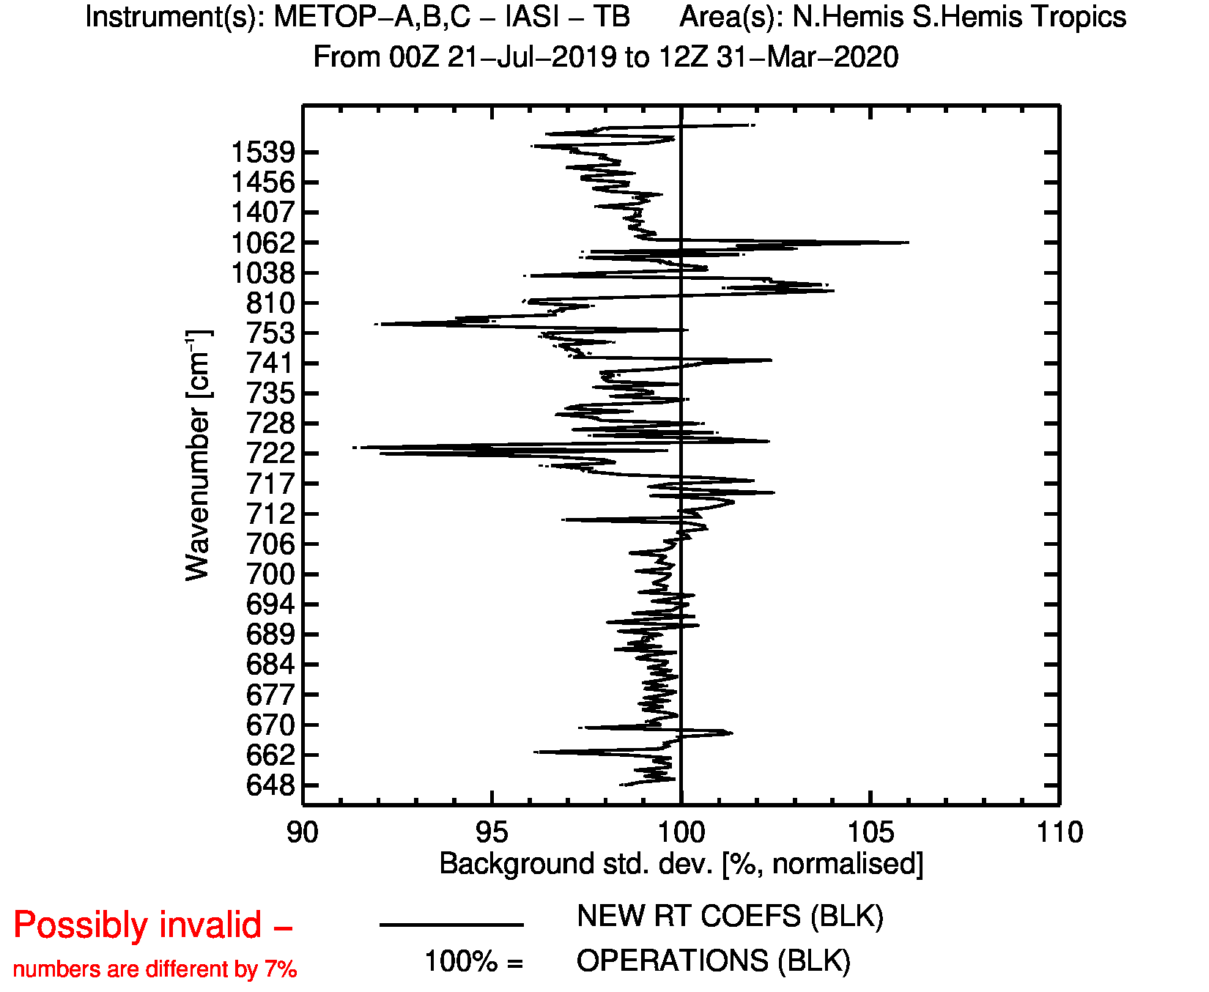
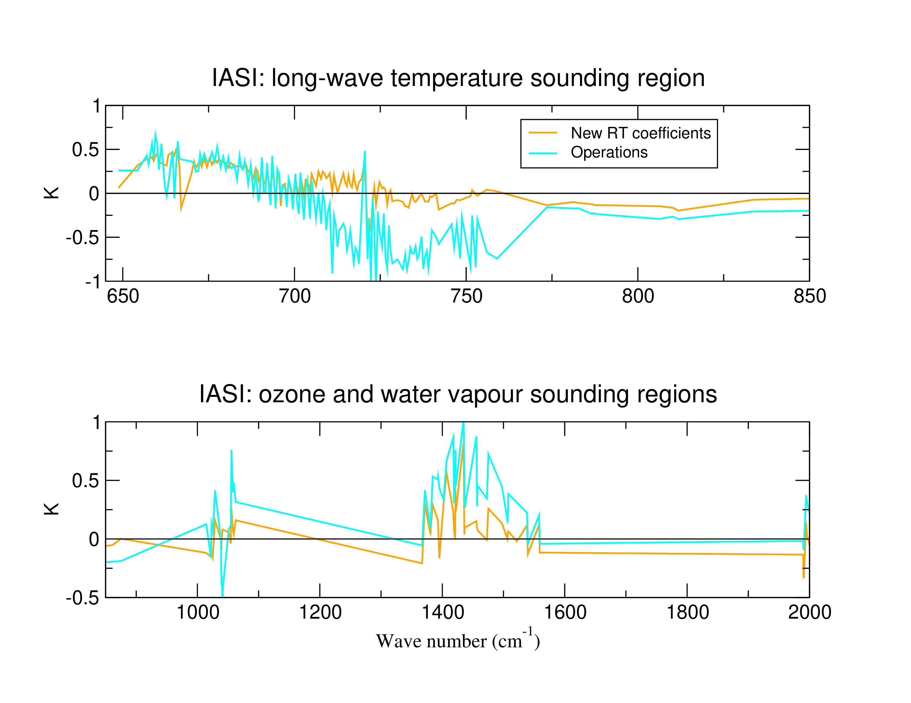
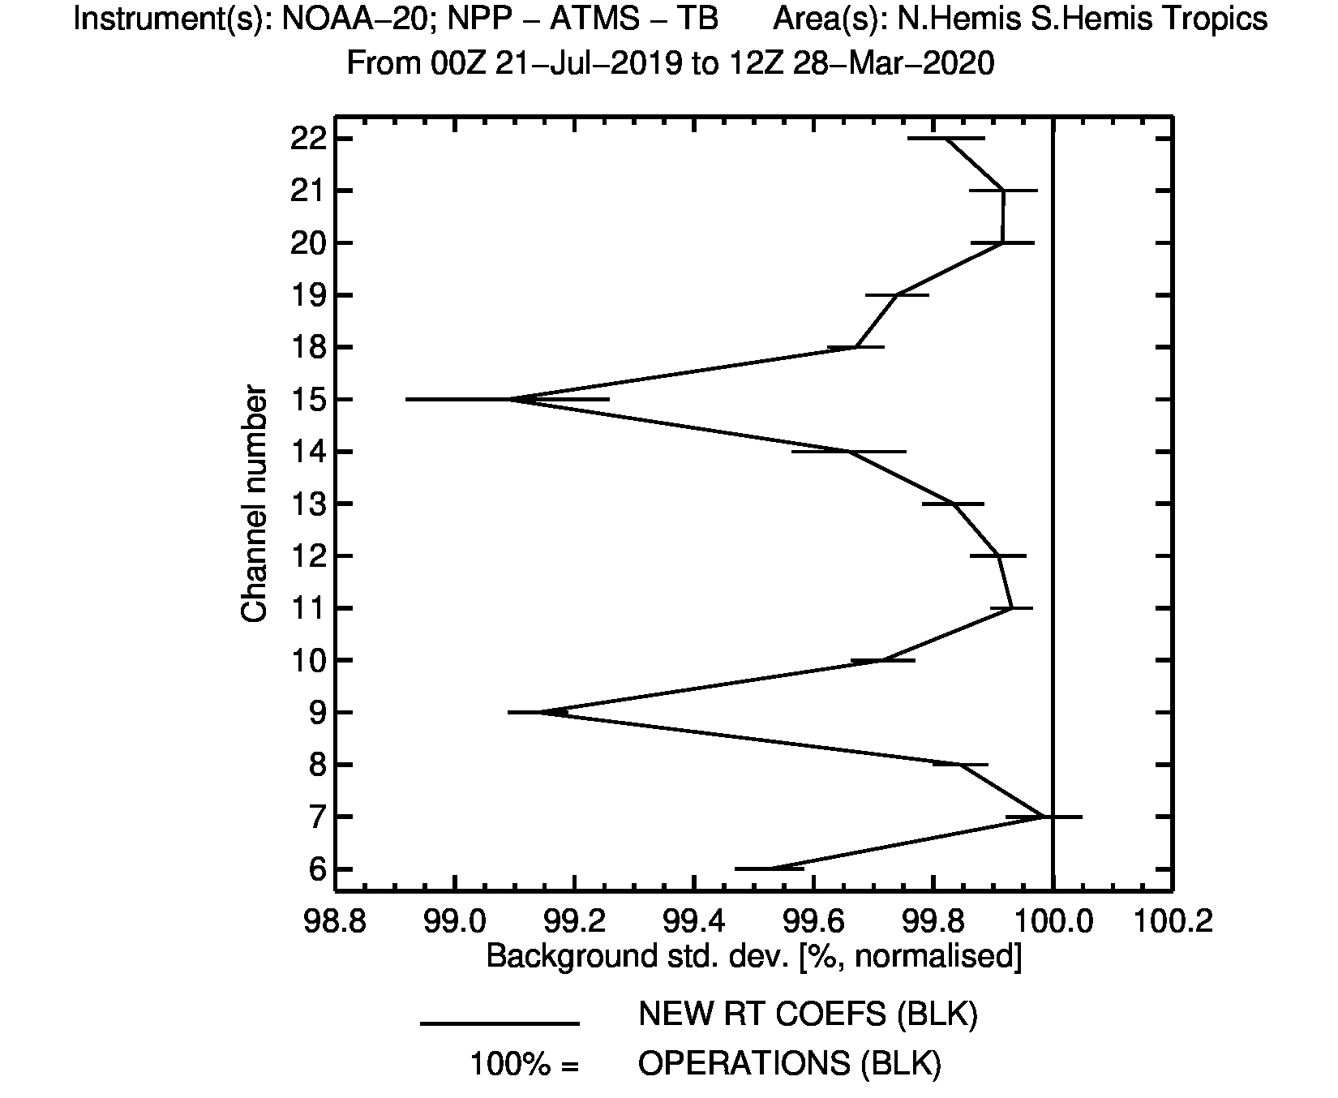
Radiative transfer improvements for IASI
Upgrade of Infrared Radiative Transfer, Spectroscopy and Trace Gas Assumptions used in the IASI simulations
State-of-the-art spectroscopy / CO₂ (CH₄) line mixing / water vapour continuum → more accurate simulations
RTTOV V9 fast transmittance model for variable CO₂ → smaller biases
Radiosonde: Temp-T
Forecast scores: temperature
IASI
IASI: bias correction
H₂O
ATMS
O₃
T: troposphere
Stratosphere
Troposphere/Surface
T: stratosphere
Ozone
Water vapour
`

Slide 12
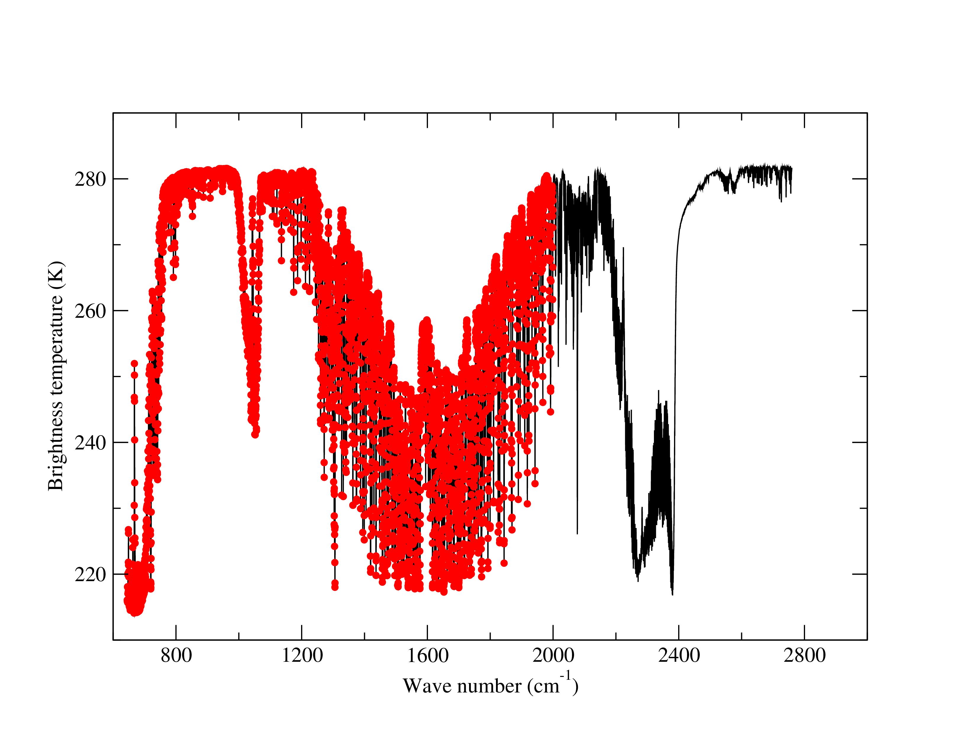
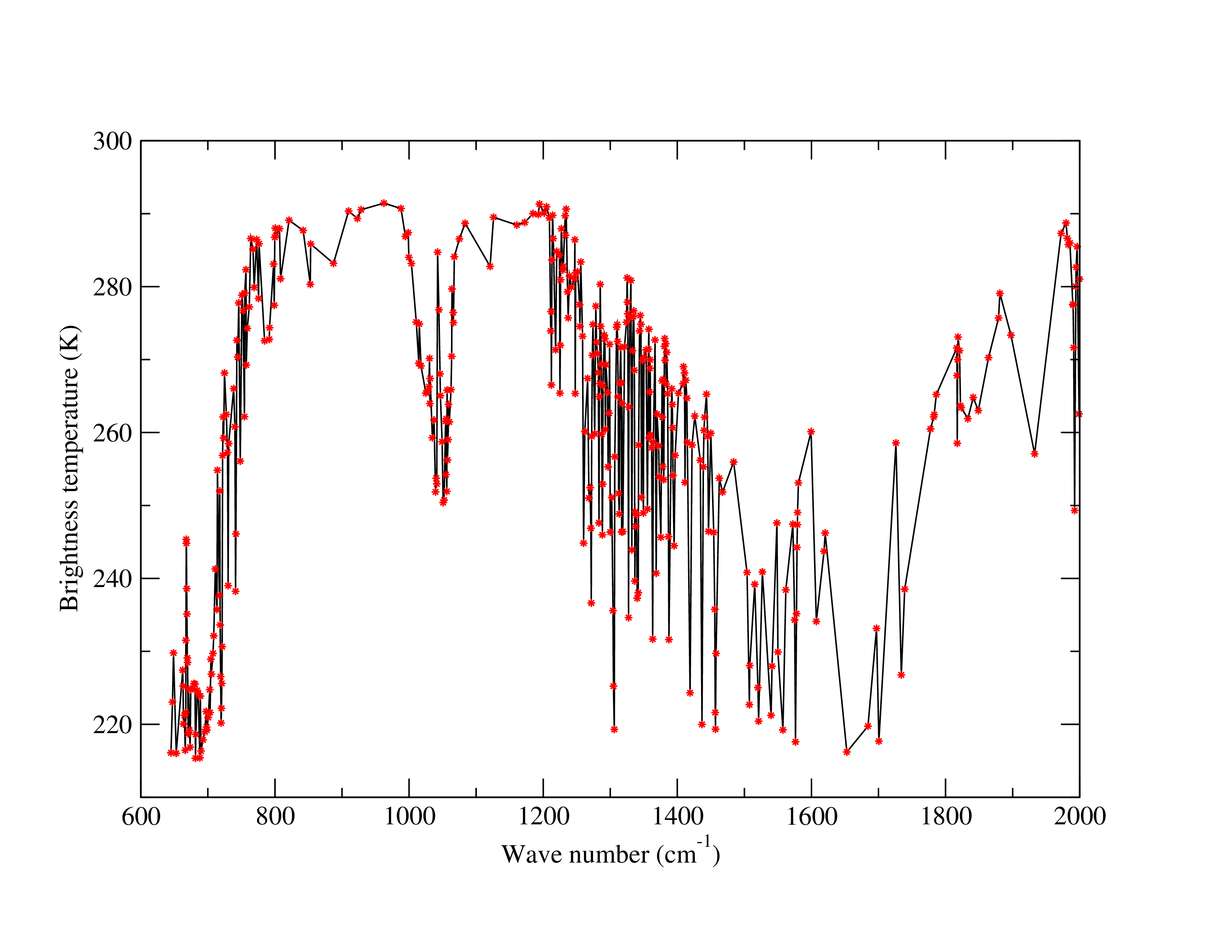
Exploitation of the full information of IASI
Technology is being developed to use the full IASI longwave and midwave spectrum using radiances reconstructed from truncated principal components
The 220 operational IASI channels
Information of 5421 IASI channels
The 400 reconstructed radiances
Assimilating 400 reconstructed radiances
By assimilating the full IASI LW/MW spectrum via reconstructed radiances derived from truncated PCA we can extract even more information from these observations.
Latest results show PCA/RR consistently outperforming traditional radiance channels assimilation

Slide 13
Impact on the forecast system (500hPa Geopotential)

Slide 14
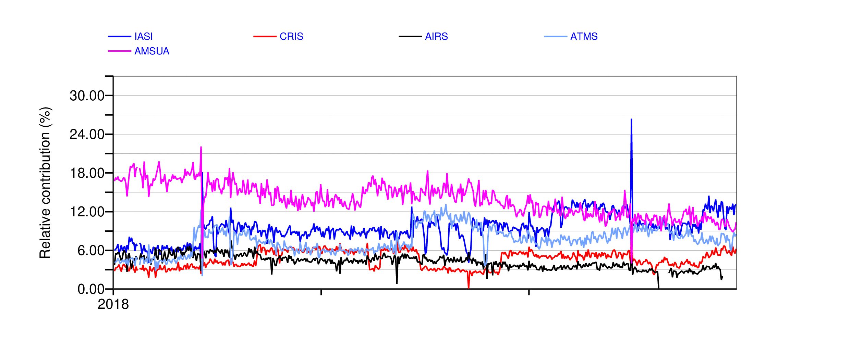
Impact of IASI: forecast sensitivity to observations (FSOI) time series

